Slide 1


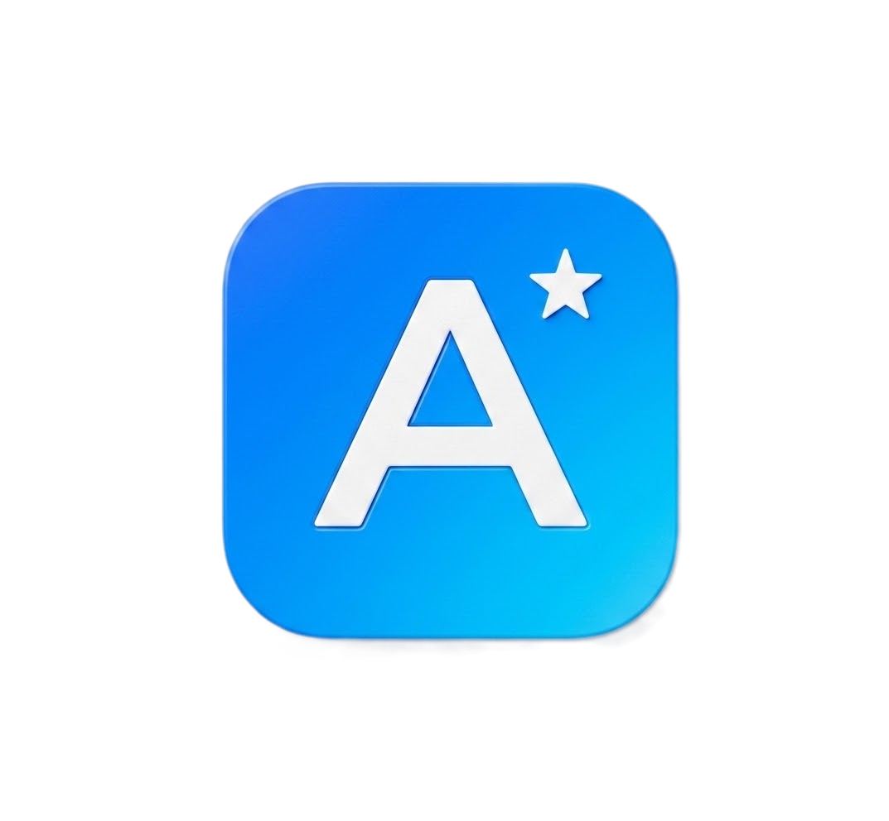
AIRAM
AI-Assisted Requirement Analysis & Management
TCS Confidential

Slide 2

Core AIRAM
The Challenge
Manual validation of automotive requirements against standards introduces severe bottlenecks:
Current Capabilities
A unified suite for automated requirement auditing, intelligent bidirectional tracing, and standard-specific knowledge retrieval.
01. Time-Consuming
Evaluating complex standard requirements manually demands massive engineering hours, severely delaying product time-to-market.
fact_check
alt_route
forum
Quality Auditor
Audits software requirements against guidelines with precision.
Intelligent RAG retrieval & strict JSON rule enforcement.
Precise PASS/REVIEW verdicts with detailed rationale.
Traceability Analyzer
Evaluates bidirectional compliance between SWE.1 & SWE.2.
LLM semantic matching identifies valid links beyond keywords.
ChatBot
Chat interface to properly communicate "Which SWE.2s cover the trigger?" instead of filtering complex tables.
.
02. Prone to Error
Human review struggles to guarantee total accuracy against dense specifications, increasing safety-critical compliance risks.
03. Highly Inconsistent
Validation outcomes and syntax reviews lack uniformity, varying widely between isolated engineering teams.
TCS Confidential

Slide 3
Scope
CURRENT SCOPE (WHAT AIRAM DELIVERS TODAY)
list_alt
fact_check
account_tree
psychology
Requirements Management
Ingest and organize requirements across SYS.1–SYS.3 and SWE.1–SWE.2 levels, with inline editing and status tracking.
Quality Analysis & Correction
AI checks against EARS syntax & INCOSE rules with auto-suggested rewrites and rationale for violations.
Traceability Analysis
Adjacent-layer link evaluation (e.g., SYS.1 to SYS.2), gap detection, and suggested missing links.
Configurable Knowledge
Adaptable analysis modes (Strict, RAG, Custom LLM) grounded in project- or OEM-specific reference docs.
FUTURE SCOPE (REALISTIC ROADMAP)
text_snippet
published_with_changes
integration_instructions
dashboard
Test Case Generation
Auto-generate test cases directly from validated requirements (SWE.4/SWE.5), pre-linked for traceability.
Change Impact Analysis
Automatically flag downstream impacts (design elements, test cases) when a requirement is edited.
Design Integration
Ingest architectural (SWE.2) & detailed (SWE.3) design artifacts with AI quality checks and bidirectional ALM sync.
Governance Dashboard
ASPICE Process Compliance Dashboard with real-time maturity indicators and code-level traceability workflows.
TCS Confidential

Slide 4
















Future Roadmap
Test Case Generation
Change-Impact Analysis
Diagram Generation
Diagram Consistency
Auto-draft verification tests (SWE.4-6) linked directly back to the source requirement ID.
Instantly flags when downstream SWE.2s and test cases go stale due to an SWE.1 edit.
Automatically draft sequence, class, and state diagrams (Sysml) from requirements sets.
Parses diagram elements visually and flags missing gaps or orphans against requirements.
Role-Based Dashboards
Chatbot
Teams / Slack Alerts
Baseline Versioning
Separate, tailored views and controls for Authors, Reviewers, and Team Leads.
Chat interface to properly communicate "Which SWE.2s cover the trigger?" instead of filtering complex tables.
Send instant notifications Or raise tickets
Freeze an approved requirement set as an immutable milestone snapshot for ASPICE audits.
TCS Confidential

Slide 5








Enterprise Governance
AUDITABILITY AND INFRASTRUCTURE SCALING
Multi-Agent Orchestrator
Full LLM Audit Trail
Log every model version, prompt hash, and confidence score per evaluation—providing full transparency beyond simple PASS/REVIEW flags.
Specialized AI agents for syntax checks, safety rule validation, and architectural tracing instead of relying on a single script.
TCS Confidential

Slide 6

Technology Stack
Frontend Framework: Angular 22 framework with TypeScript, utilizing a clean, component-based architecture and real-time SSE streaming for long-running processes.
Backend Architecture: High-performance FastAPI application written in Python 3.10+, backed by an embedded SQLite database (with Postgres readiness for cloud).
AI & Foundation Models: Powered by the NVIDIA NIM API, utilizing the state-of-the-art Llama 3.3 Nemotron 49B model and nv-e5-v5 for highly accurate embeddings.
Vector Storage: Integrates seamlessly with Qdrant Cloud for robust semantic search, context retrieval, and fast document metadata filtering.
TCS Confidential

Slide 7
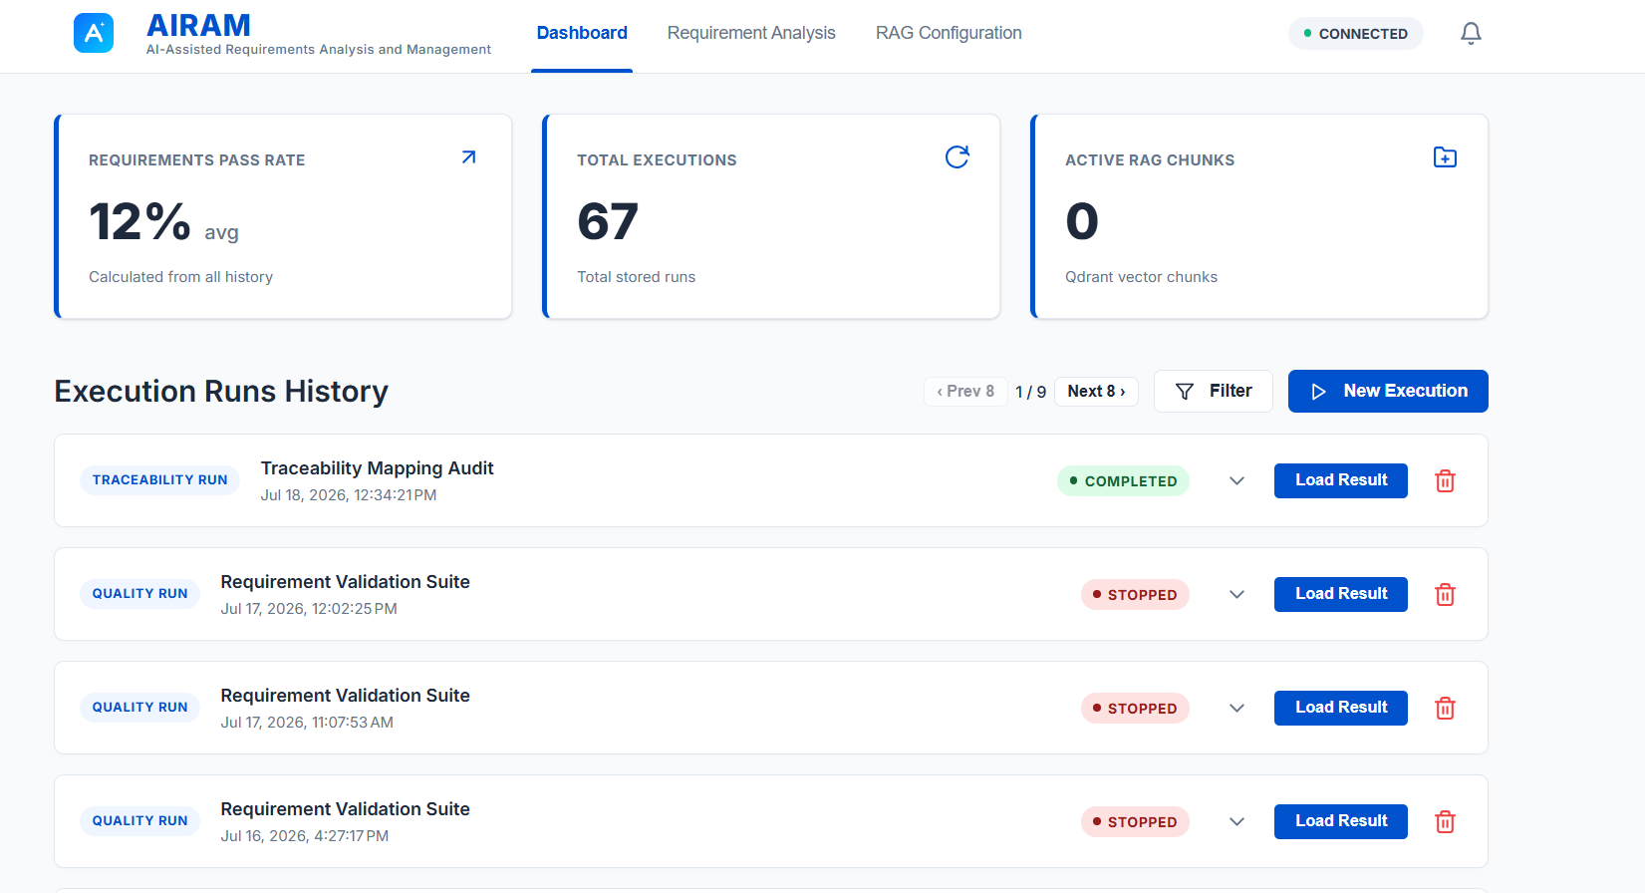
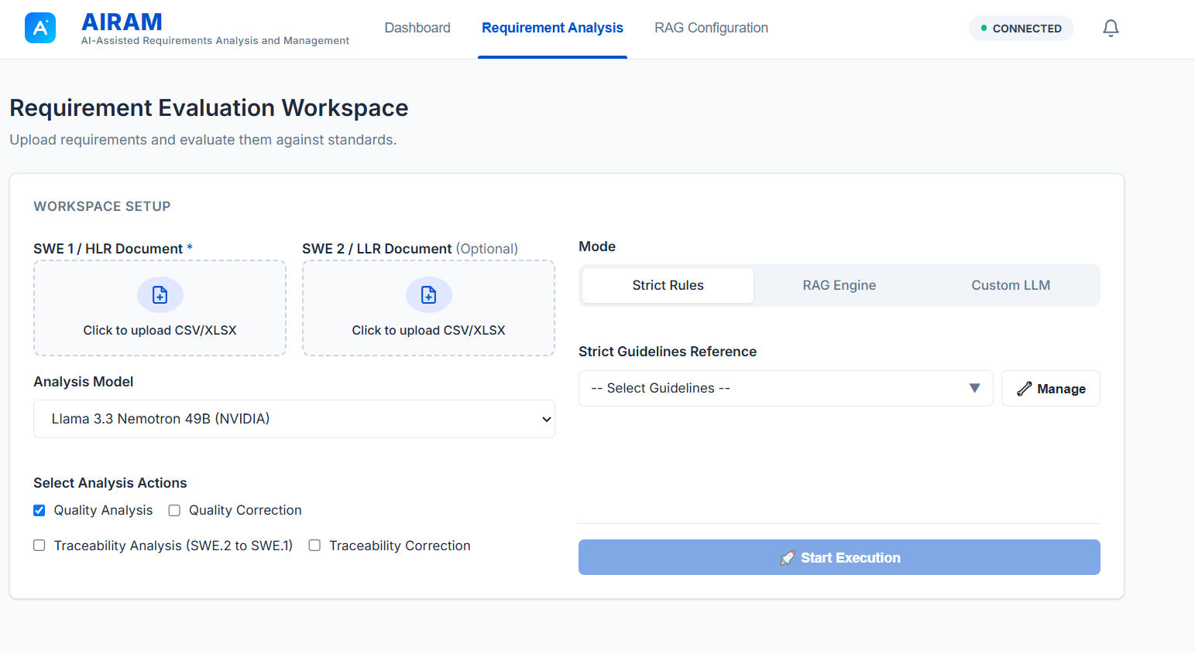
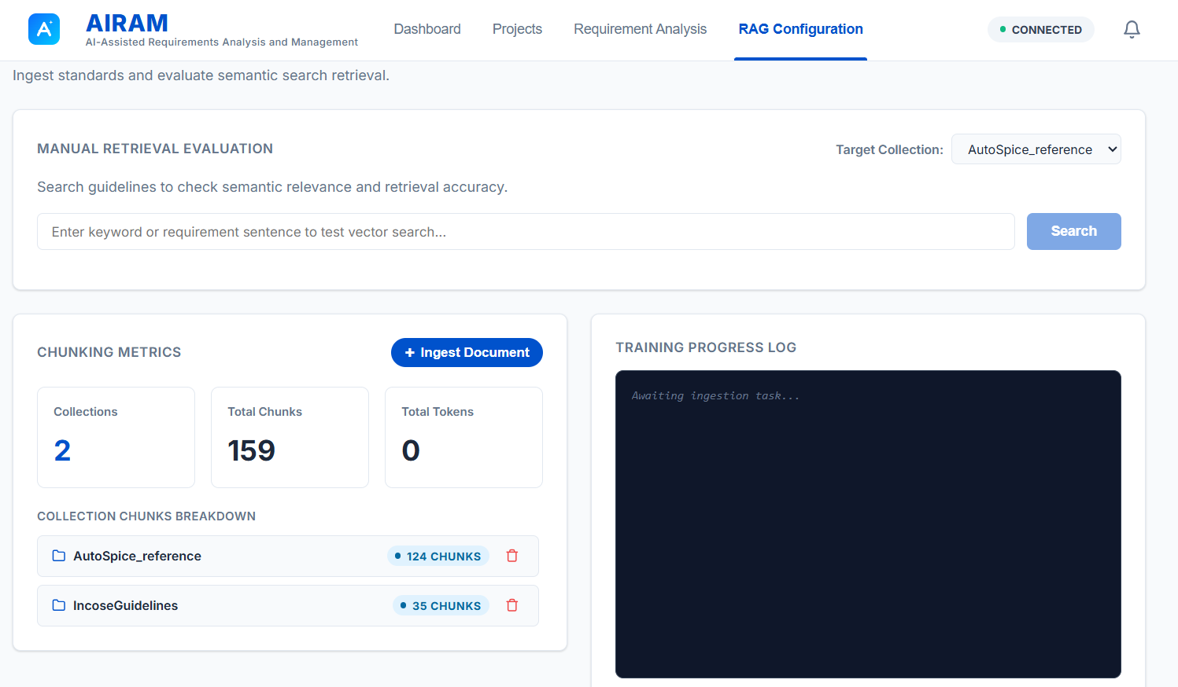


Platform Interface Overview
Dashboard Analytics
Evaluation Workspace
Knowledge Config
Track compliance trends and execution history.
Upload files and control real-time analysis execution.
Manage standards and evaluate semantic retrieval.
TCS Confidential

Slide 8

Thank you

Slide 9
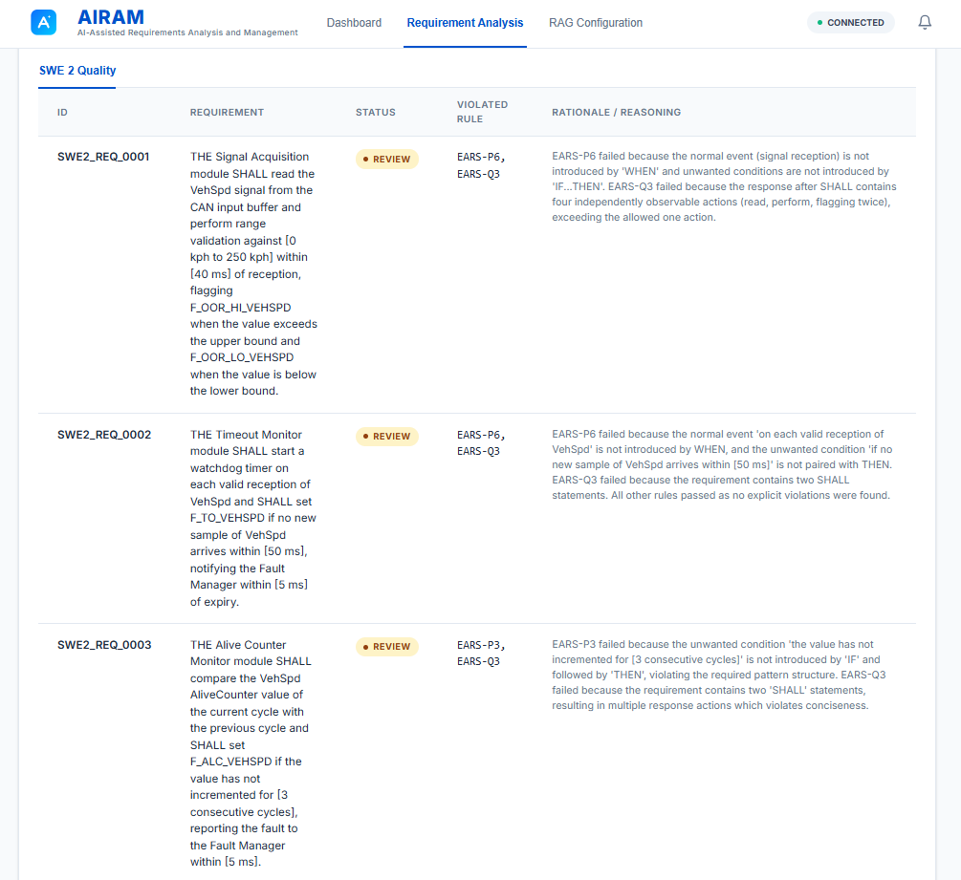
Current Capability: Quality Auditor
The core evaluation engine audits individual software requirements against strict engineering guidelines with unprecedented accuracy.
It supports intelligent RAG retrieval, strict JSON rule enforcement, and custom evaluation contexts to deliver precise PASS/REVIEW verdicts with detailed, structured rationale.
A secondary LLM recheck mechanism ensures subtle violations missed in the first pass are captured, guaranteeing assessment rigor.
TCS Confidential

Slide 10
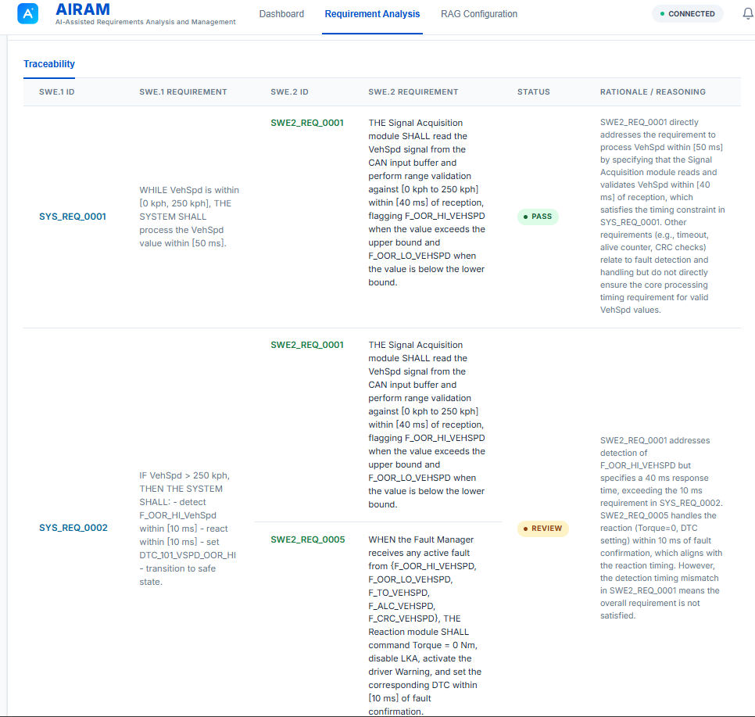
Current Capability: Traceability
Analyzer
•
Evaluates bidirectional tracing compliance between High-Level (SWE.1) and Low-Level (SWE.2) requirements effortlessly.
•
Utilizes Large Language Model semantic matching to accurately identify valid requirement links, going beyond simple keyword searches.
•
Automatically flags orphaned SWE.2 requirements lacking parent HLR coverage to prevent scope creep.
•
Processes large datasets efficiently with intelligent context window management and batch execution.
TCS Confidential

Slide 11


Advanced Knowledge (RAG) Engine
Semantic Retrieval
Provides highly relevant engineering guidelines as direct context for LLM audits. This ensures that automated compliance checks are deeply rooted in your organization's specific standards, rather than generic AI knowledge.
Intelligent Ingestion
Progressively parses and intelligently chunks complex documentation including PDFs, Excel sheets, CSVs, JSON, and TXT files. It leverages cutting-edge extraction models to embed data into a highly scalable Qdrant vector database.
TCS Confidential

